Slide 1
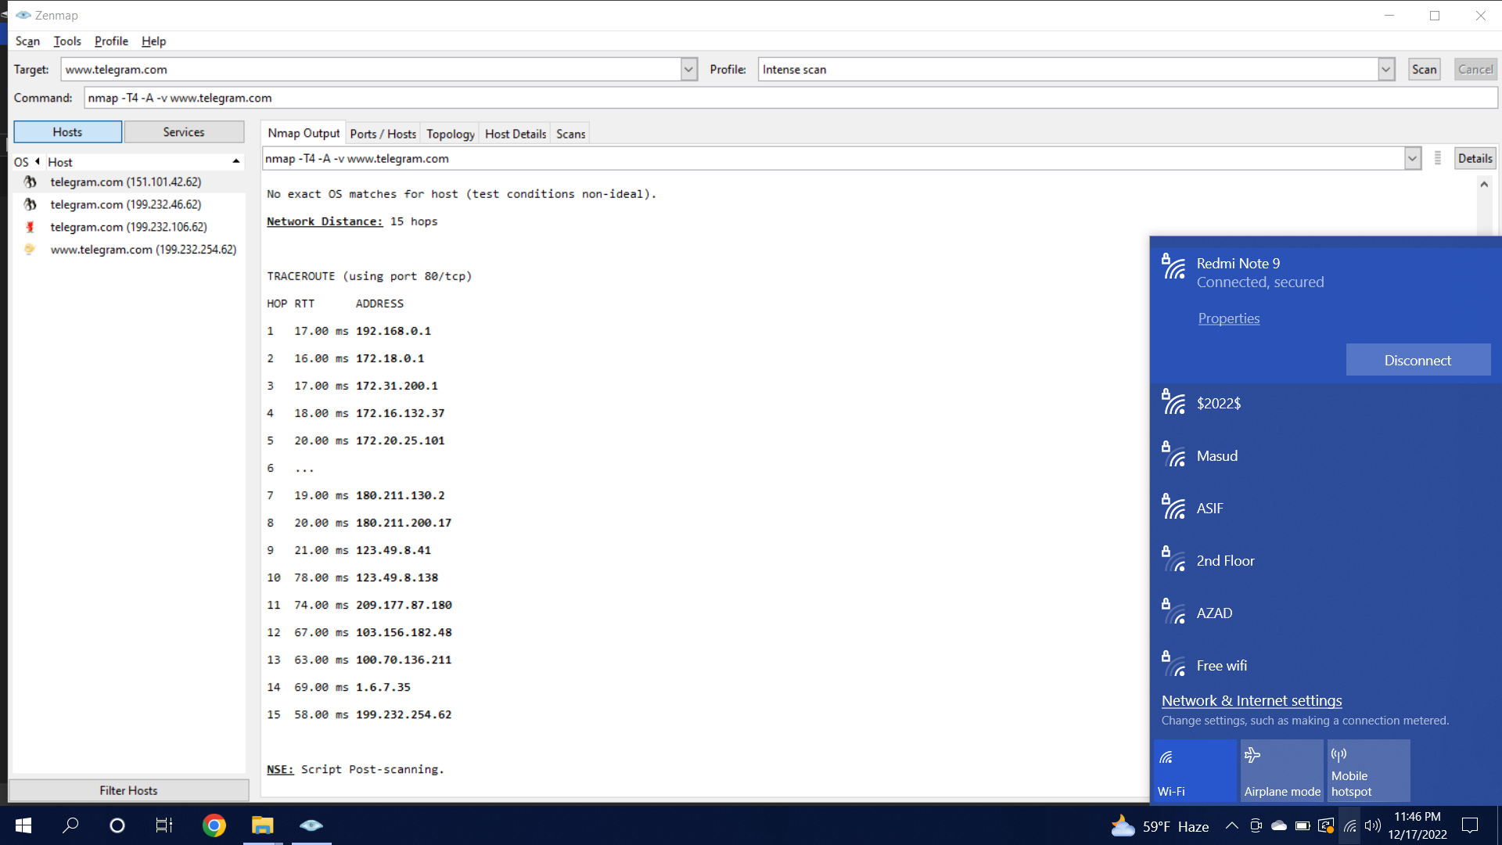
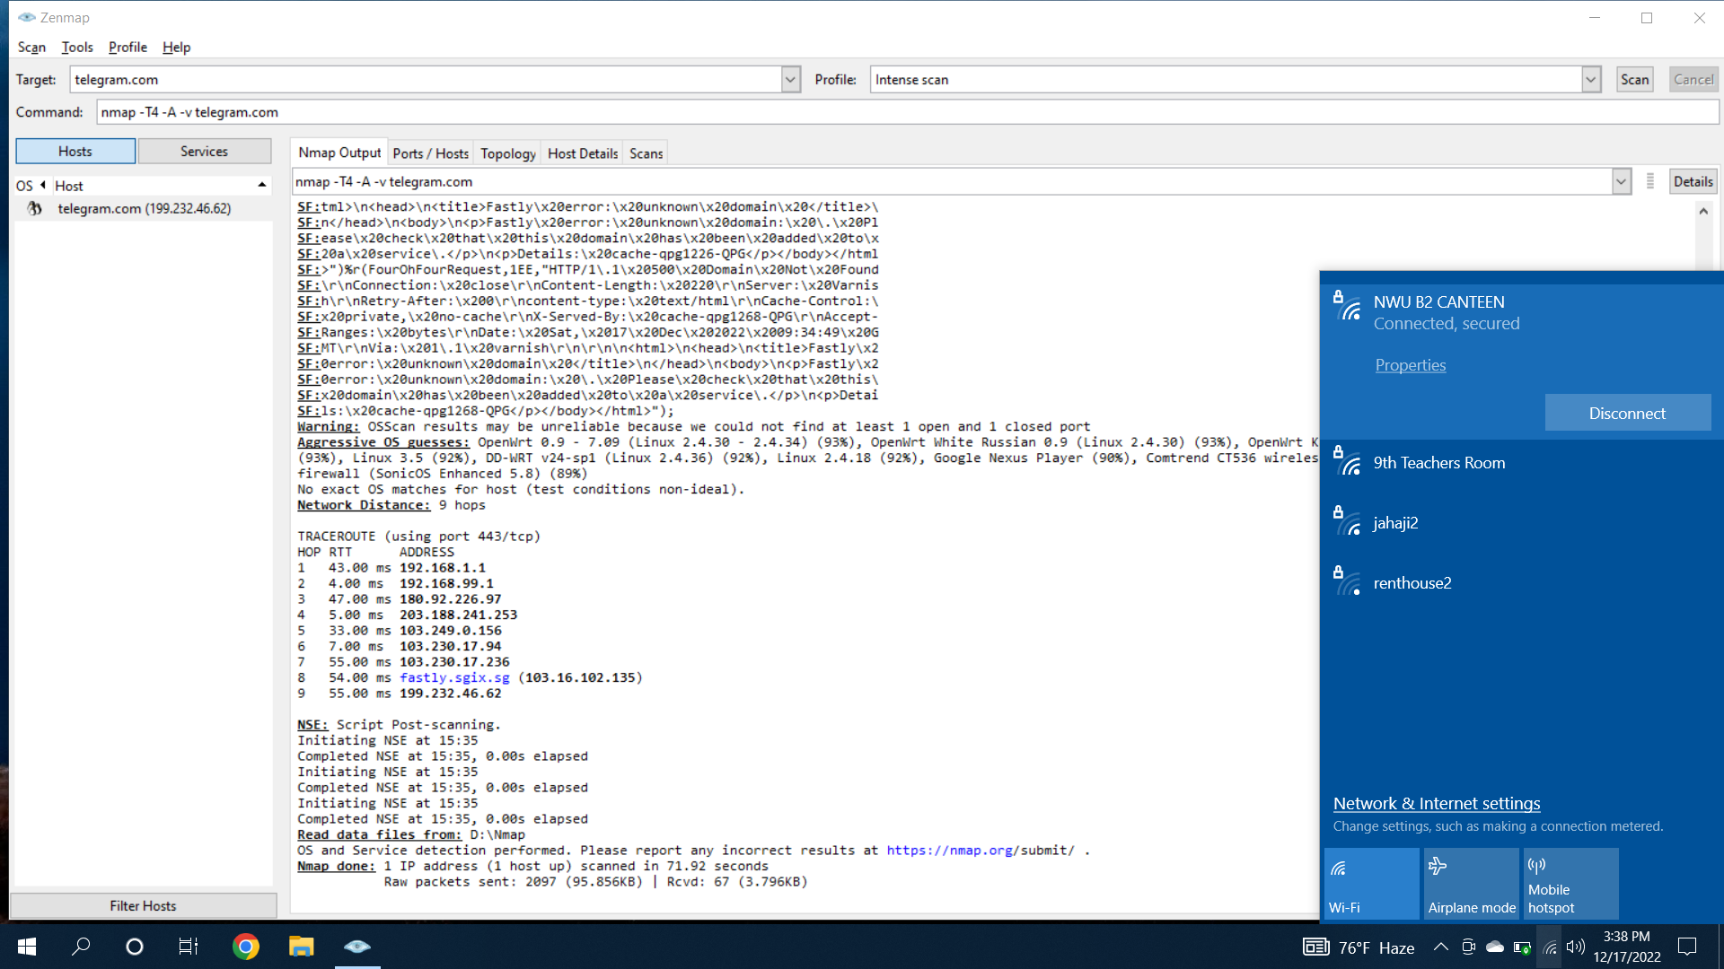
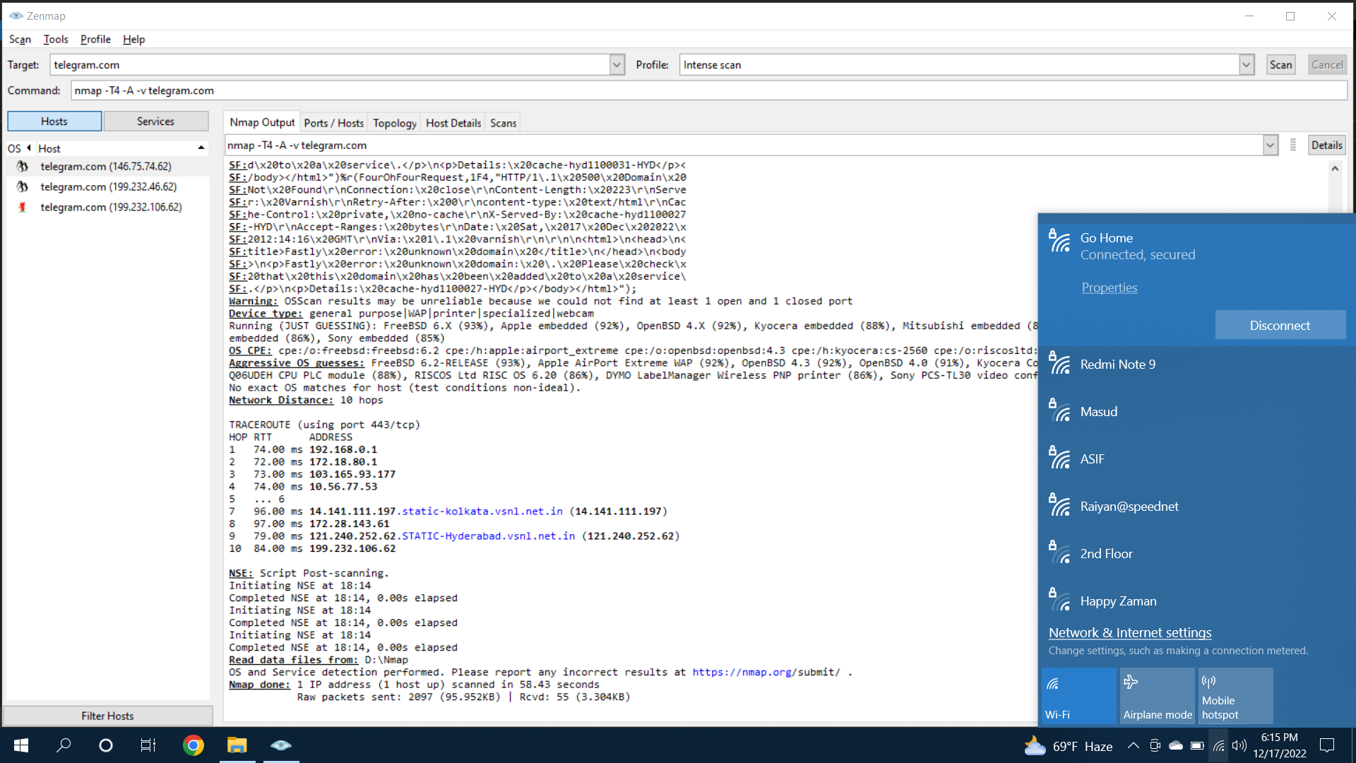
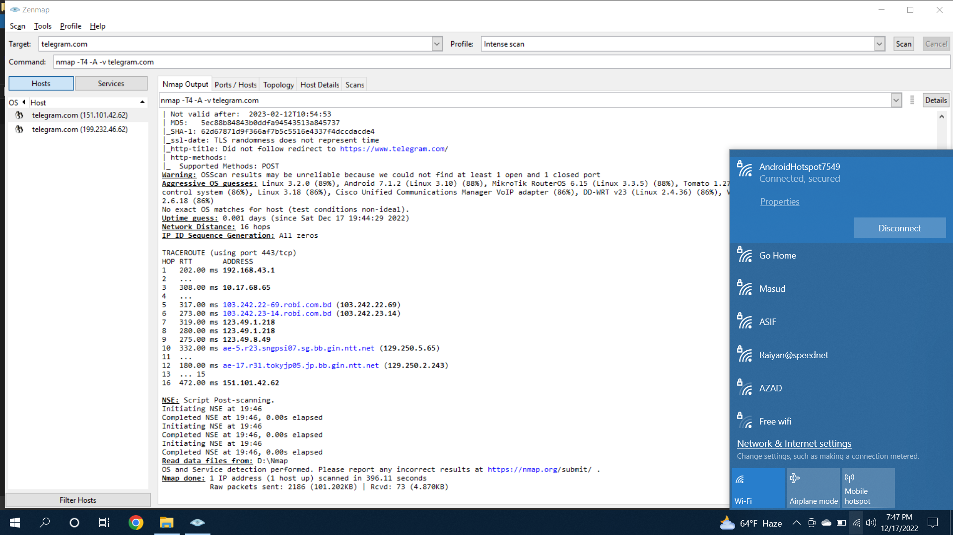
Different Host to Domain: Telegram
GP
Link3
Sparkit
Teletalk
SP CSE-3304

Slide 2
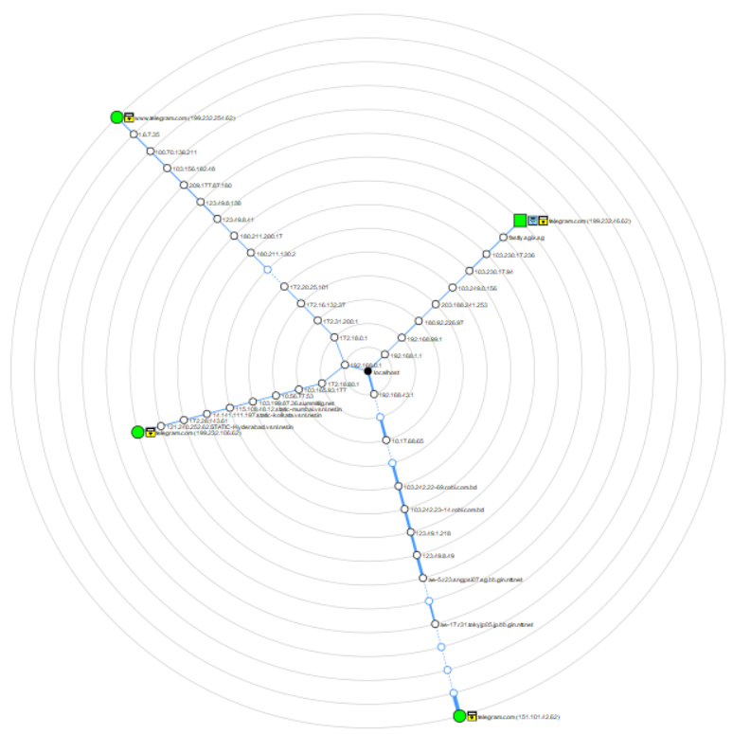
Design network topology
Design network topology
SP CSE-3304

Slide 3

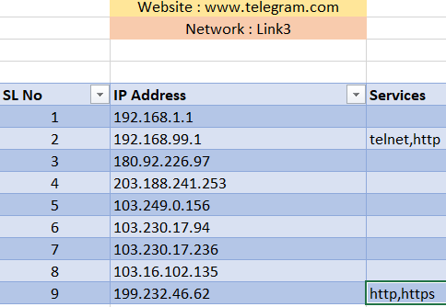
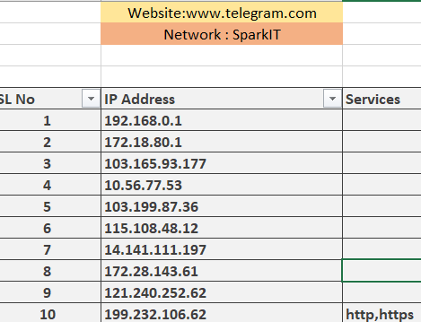
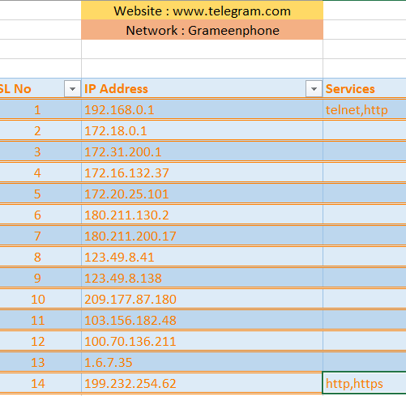
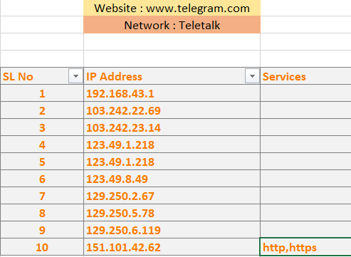
Fig 8: Service table of Link3
Fig 9: Service table of SparkIT
Excel sheet for network diagram
Fig 9: Service table of Grameenphone
Fig 10: Service table of Teletalk
SP CSE-3304

Slide 4
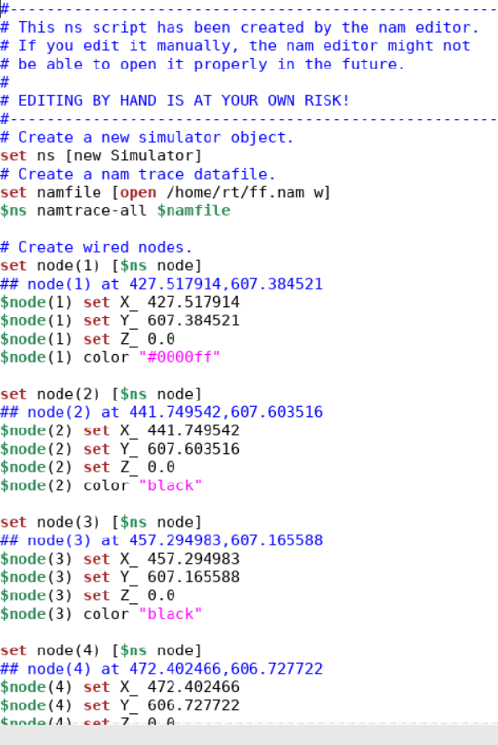
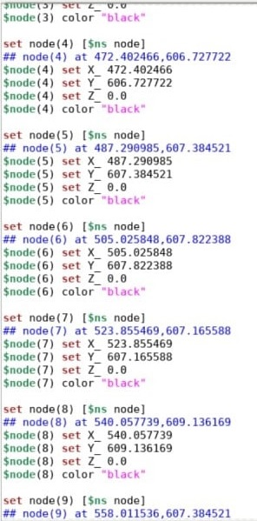
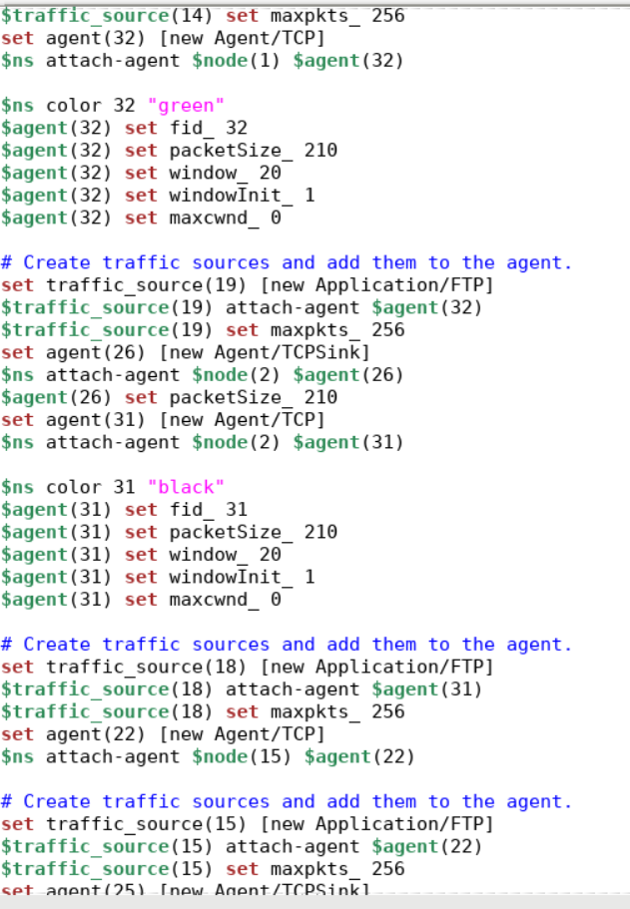
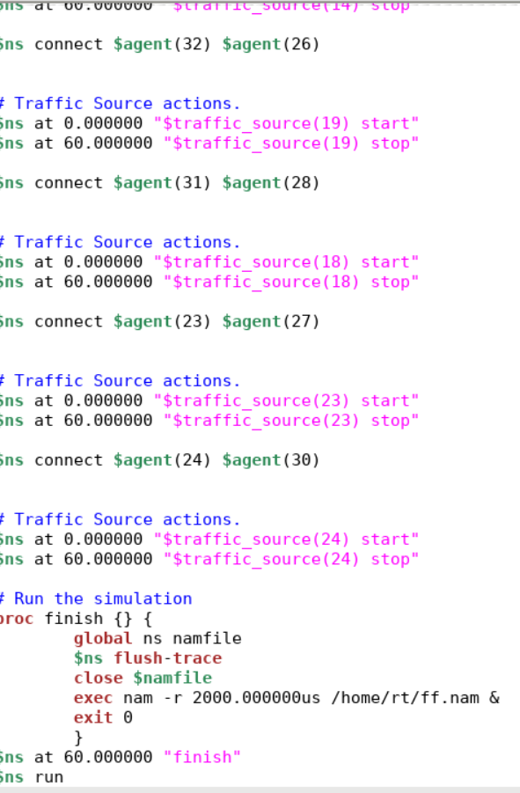
Introduction to NS2
Network Simulator 2 is simply a discrete event-driven network simulation tool for studying the dynamic nature of communication networks. Network Simulator 2 provides substantial support for simulation of different protocols over wired and wireless networks.
SP CSE-3304

Slide 5
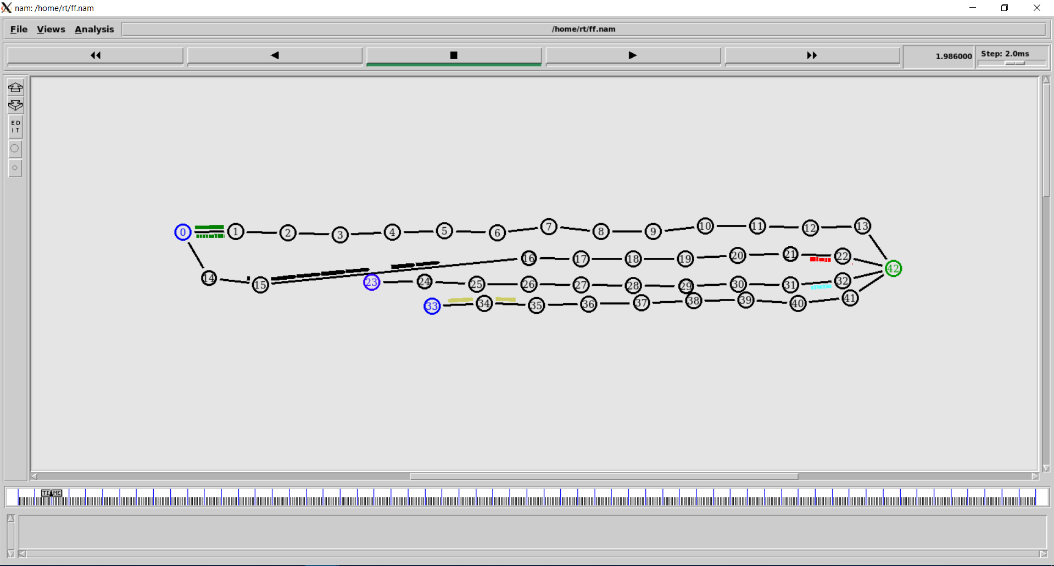
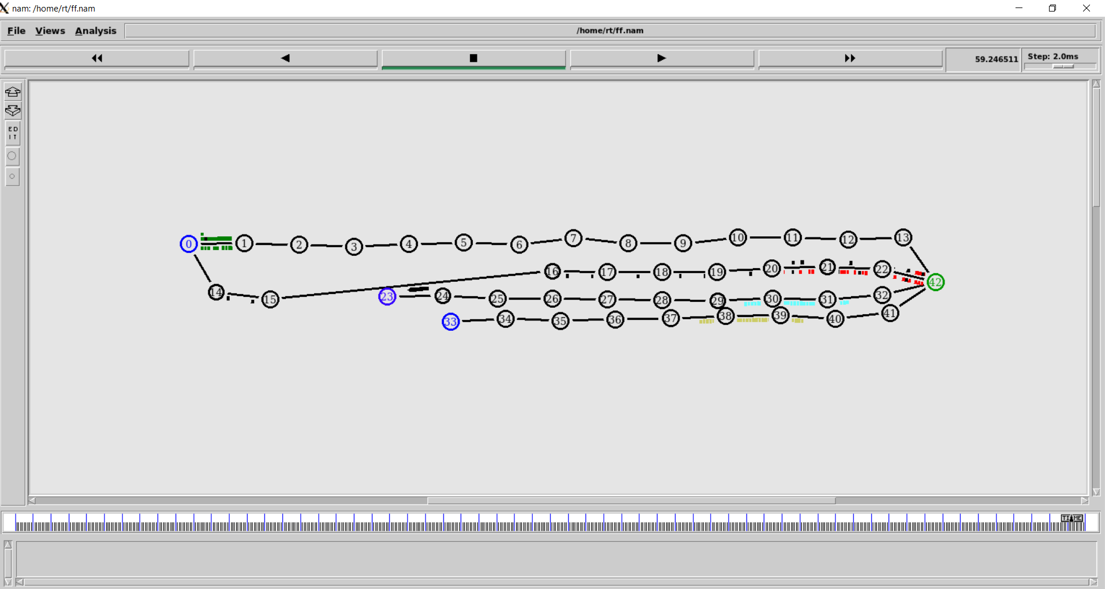
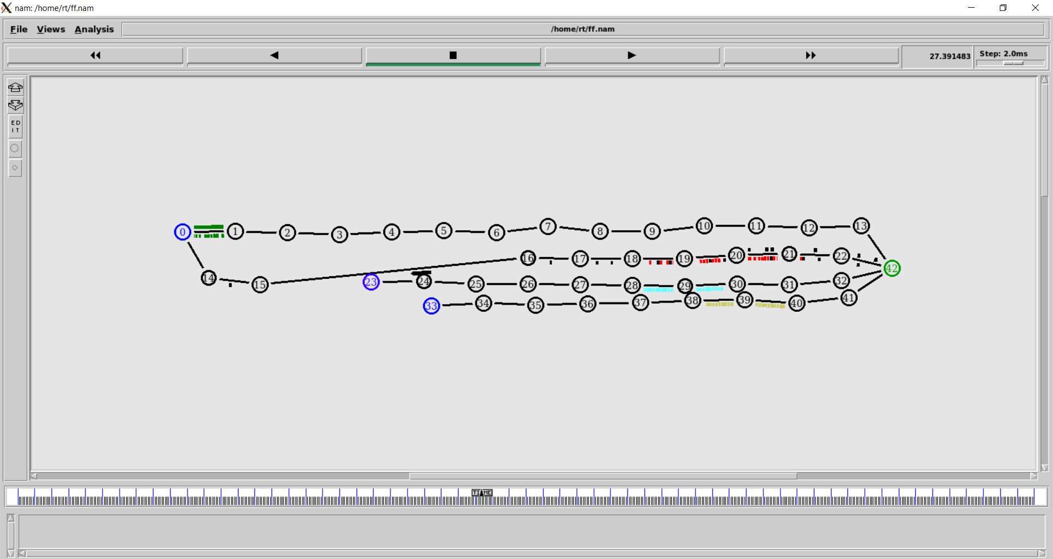
Output topology of NS2
Here this data packet is very small and there started to going to the target point.
Fig: First output of NS2
Here this data packets are going to the target point and the target point are sending back the data.
Fig: Second output of NS2
Here this data packets are going to the target point, but the data packets are very smaller, and they are return into starting point.
SP CSE-3304
Fig: Third output of NS2

Slide 6

Summarization of the designed network
In Zenmap frequently used scans can be saved as profiles to make them easy to run repeatedly. It arranges its display to show all ports on a host or all hosts running a specific service.
After scan 4 different host to the domain telegram.com we find 4 different topology design.
After completed all 4 scans in Zenmap collect all IP addresses of the 4 different network and store in a excel sheet and prepare a final sheet of all 4 networks organized level by level.
Network Simulator 2 (NS2) provides substantial support for simulation of different protocols over wired and wireless networks. It provides a highly modular platform for wired and wireless simulations supporting different network elements, protocols, traffic, and routing types.
Source code is used in NS2 to demonstrate network flow.
Finally, four different source use NS2 to pass data packet to reach the destination telegram.
SP CSE-3304

Slide 7

Conclusion
We got a huge knowledge in computer network lab. But we have some technical issues in zenmap.
It might takes lots of time to scan. We hope this will be fixed in the future.
SP CSE-3304

Slide 8

References
https://ipwithease.com/introduction-to-zenmap-nmap network-mapper/
https://link.springer.com/chapter/10.1007/978-1-4614 1406-3_2
https://nmap.org/book/zenmap-results.html
SP CSE-3304

Slide 9

THANK YOU
SP CSE-3304

